Slide 1

Integrated Project–II | Progress Review –1
Smart Agriculture System using AI for Disease Detection and Farmer Market
Department of Computer Science & Engineering
CHITKARA UNIVERSITY, HIMACHAL PRADESH
Submitted To: | Submitted By:
Ms. Tanu Minhas | 1. Ravi kumar (2411981457)
 | 2. Saksham Yadav (2411981485)
 | 3. Ritish Sharma (2411981466)

Slide 2
Agenda
Project Overview
Requirement Gathering & Data Collection
Design Phase
Development Kickoff
SDG Goals Mapping
Multidisciplinary Approach
Novelty Factor
Challenges & Risks

Slide 3
Project Overview
Problem statement: Farmers often struggle to identify plant diseases early, which can reduce crop yield and quality.
An AI-based system can help detect diseases from leaf images and support farmers in taking timely action.
Objective: To develop an AI-based smart agriculture system that detects plant diseases from leaf images and provides fertilizer recommendations and vegetable market prices to help farmers improve crop management and profit.
Scope of the System:
Detect plant diseases using AI model
Suggest fertilizer and treatment
Show vegetable nearby market prices
Role based login for Farmer and Market Manager
Maintain history for registered users

Slide 4
Stakeholders:
Farmers – To detect plant diseases early and get fertilizer suggestions.
Market Managers – To manage vegetable prices and market listings.
Agricultural Researchers – To study plant diseases and improve farming techniques.
Agriculture Departments – To support farmers with modern agricultural technology.
Students and Developers – To research and develop smart agriculture solutions.

Slide 5
Requirement Gathering & Data Collection
Sources of Data:
Plant leaf images collected from datasets and online sources. (https://www.kaggle.com/)
Agricultural research papers and literature review. (https://link.springer.com/article/10.1186/s13007-025-01450-0) Published: 28 October 2025
Observation of diseased plant leaves.
Existing Datasets / Literature Review
Public datasets like Plant Village dataset used for training.
Previous research on plant disease detection using machine learning and image processing.
Functional Requirements
Upload plant leaf image.
Display disease result to the user and Suggested Fertilizer

Slide 6
Non-Functional Requirements
Easy to use interface.
Fast and accurate detection.
Reliable system performance.
Challenges in Data Collection
Getting high-quality leaf images.
Different lighting and background conditions.
Similar appearance of some diseases.
Current Status of Project:
Dataset collected and studied.
Basic model and research completed.
System development and testing in progress.

Slide 7
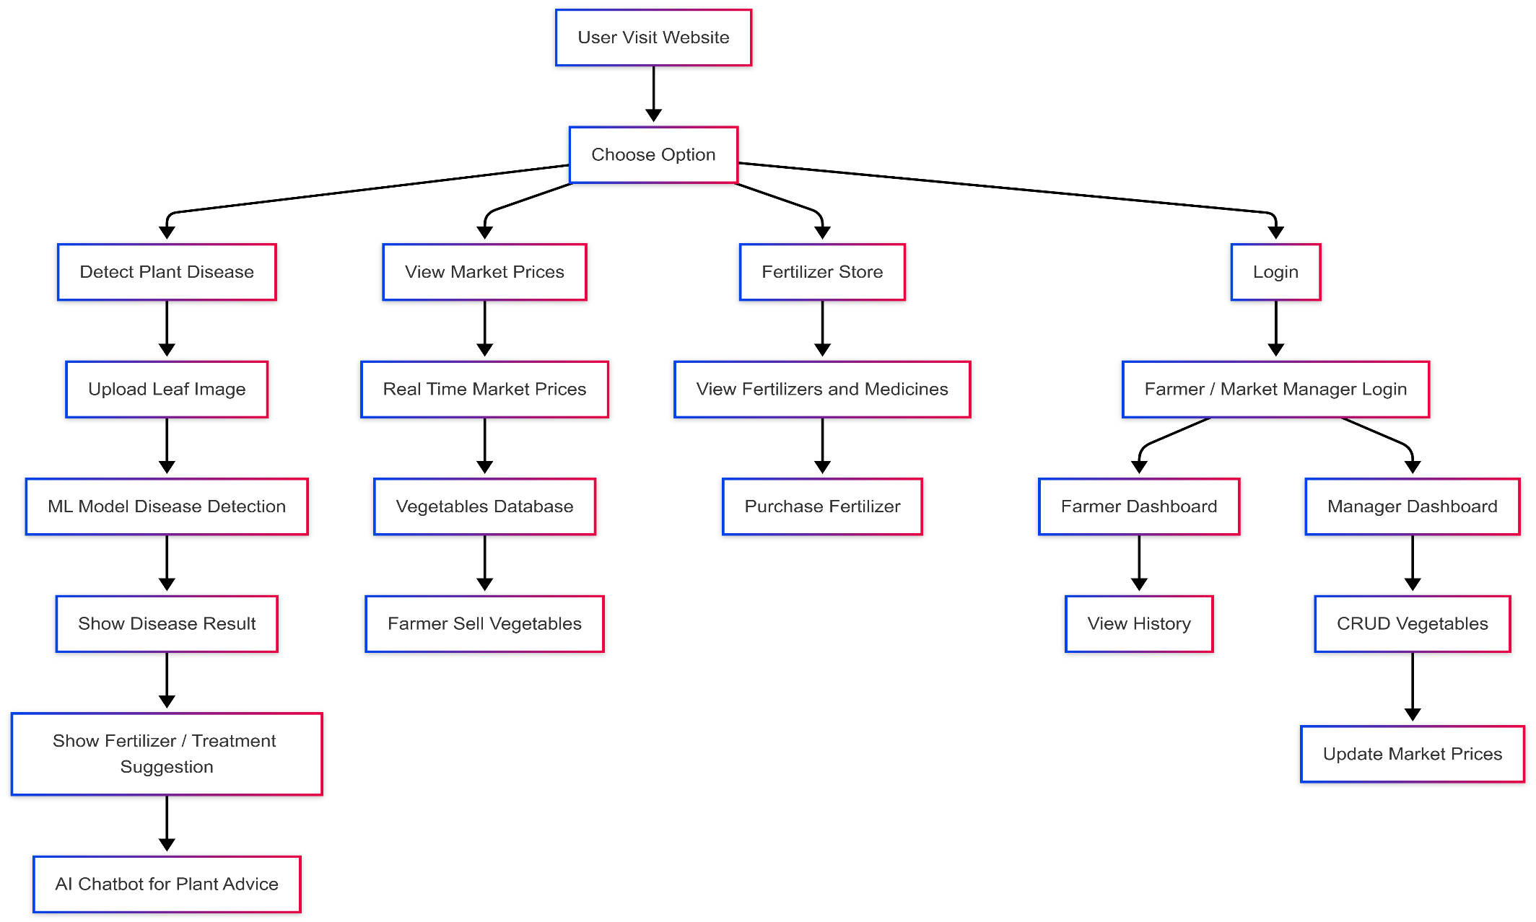
Design Phase
Use Case Diagram

Slide 8
Data Flow Diagrams (DFDs)
Farmer → Upload Plant Leaf Image
System → Process Image using AI Model
System → Detect Plant Disease
System → Display Disease Result and Fertilizer Suggestion
Market Manager → Add / Update Vegetable Prices
System → Store Vegetable Data in Database
Farmer / User → View Real-Time Market Prices

Slide 9
Architecture & Tech Stack
Frontend (User Interface) • HTML, CSS, JavaScript / React • Allows users to upload images and view results
Backend (Server Logic) • python Flask • Handles API requests and business logic
AI Model (Disease Detection) • Machine Learning / CNN model • Detects plant diseases from leaf images
Database (Data Storage) • MongoDB • Stores user Data

Slide 10
Development Kickoff
Initial Codebase Setup
Development environment and tools setup.
Required libraries installed (Python, TensorFlow, OpenCV).
Dataset collected and organized.
Initial AI model structure created.
Basic system testing started.

Slide 11
SDG Goals Mapping
SDG 2 – Zero Hunger: Helps improve crop production by detecting plant diseases early.
SDG 12 – Responsible Consumption and Production: Reduces crop loss and promotes efficient use of agricultural resources.
SDG 15 – Life on Land: Supports healthy plant growth and sustainable farming.
Potential Impact
Helps farmers identify plant diseases quickly.
Reduces crop damage and improves productivity.
Saves time and cost in manual disease detection.

Slide 12
Multidisciplinary Approach
Fields Involved:
Artificial Intelligence / Machine Learning: Used to detect plant diseases from leaf images.
Data Science: Used for dataset collection, analysis, and model training.
Team Collaboration
Team members work together on data collection, model development, and testing.
Tasks are divided such as research, coding, dataset preparation, and documentation.
Interdisciplinary Innovation
Combines technology and agriculture to solve real farming problems.
Uses AI and data analysis to create a smart solution for plant disease detection.

Slide 13
Novelty Factor
What Makes This Project Unique
Uses AI / Machine Learning to automatically detect plant diseases from leaf images.
Faster and more accurate than traditional manual disease identification.
Helps farmers detect diseases at an early stage.
Provides fertilizer suggestions for proper treatment.
Displays nearest vegetable market prices to help farmers choose the best market.
Comparison with Existing Solutions
Traditional method: Farmers identify diseases manually which takes time and may be inaccurate.
Proposed system: Image-based automatic detection using machine learning for better accuracy and speed, Shows nearest market prices, Helps farmers compare and choose the best market

Slide 14
Challenges & Risks
Key Challenges Faced So Far
Different lighting conditions and backgrounds in images.
Some plant diseases look very similar, making detection difficult.
Limited dataset for certain plant diseases.
Identified Risks & Mitigation Strategies
Incorrect disease prediction.
Insufficient or unbalanced dataset.
Model accuracy issues.

Slide 15
Thank You

